Slide 1

Intelligent Firmware Trace analysis Tool
Parth Pathak
Farida Shaikh

Slide 2

Problem Statement
There is a huge amount of effort, time and money spent on the defect triaging and analysis by the developer.
In addition, the respective developer needs to have deep expertise on the domain to narrow down the problematic area and identify the root cause.
Currently, on triggering a test case in case of an ERROR developer has to manually go through the gtraces generated in the stdout file and has to search for the “_ERROR” string.
After getting the ERROR trace, according to the respective line number developer needs to search whole codebase which contains approximately 100K code files and this seems to be more laborious, time consuming and it drastically reduces the overall efficiency of development process.

Slide 3
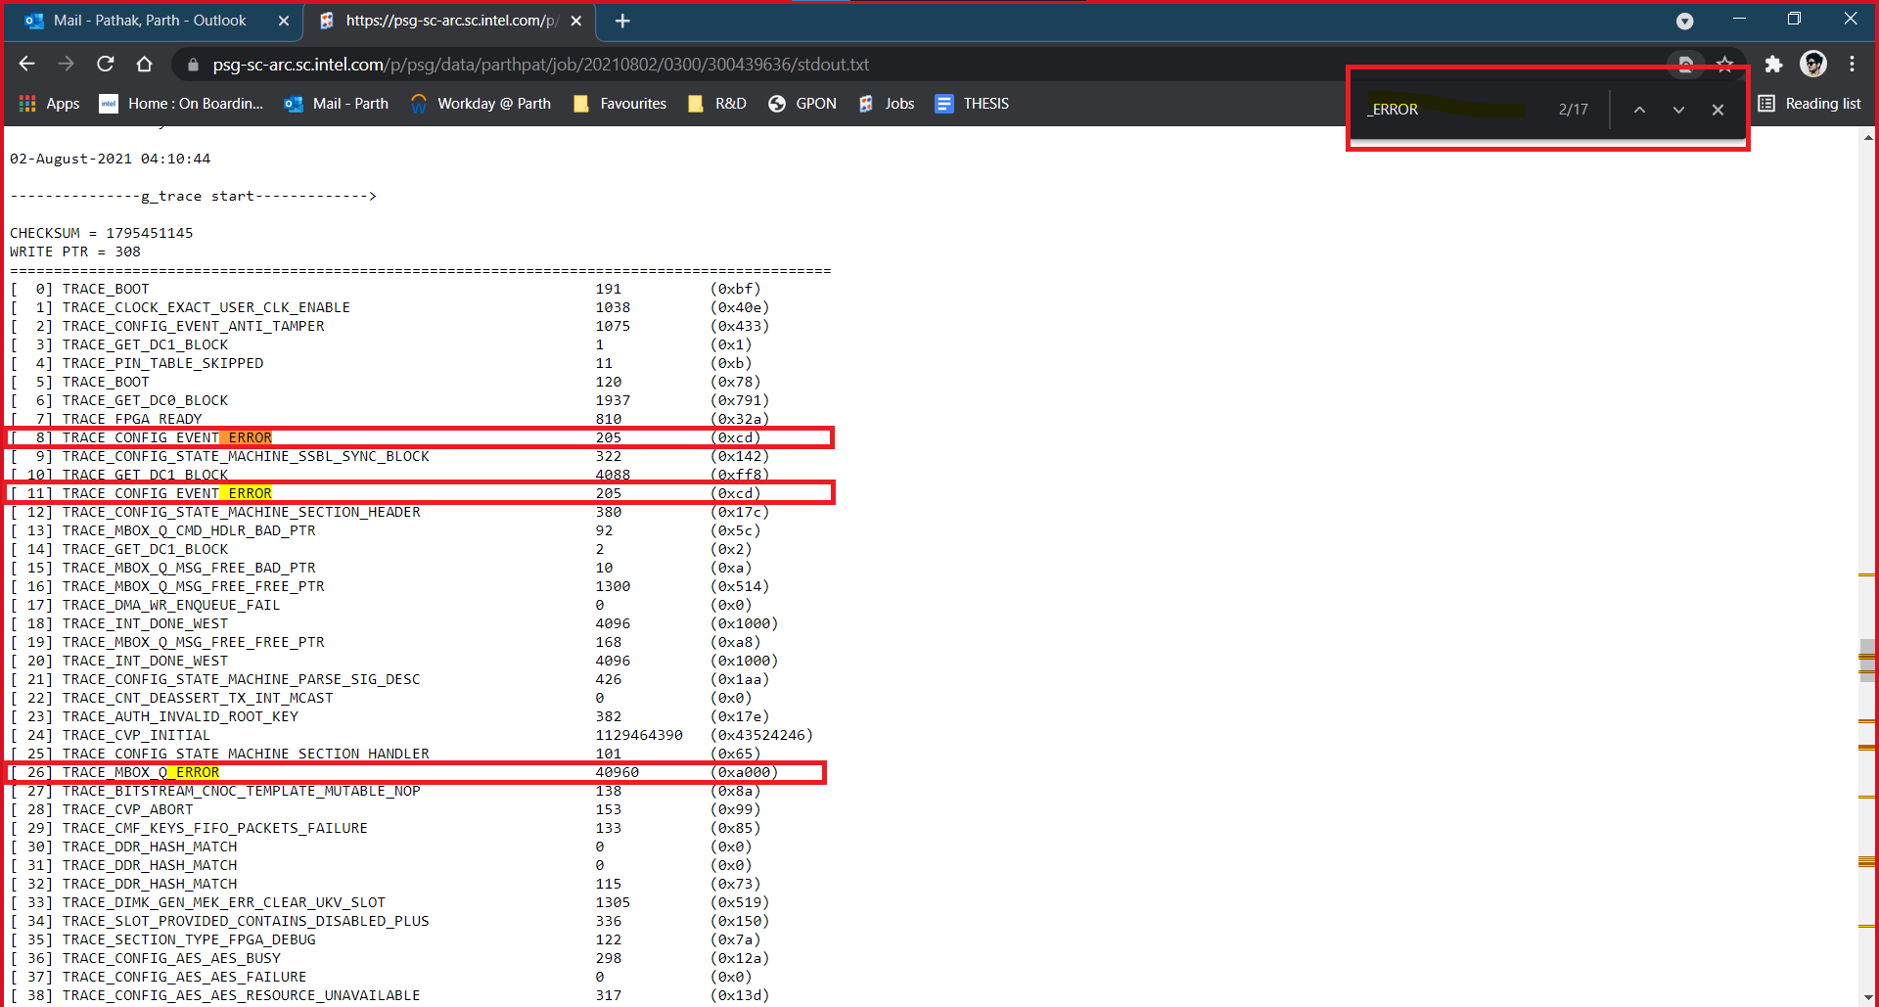
Problem Statement (Cont.)

Slide 4

Objective
How it works:
1
With an automated tool doing the first level of triaging and analysis of the issues, it can shorten the defect life cycle and reduce the overall cost/effort of analysis.
2
It will also reduce the dependency on a specific developer.
3
Tool helps to parse the available trace information and provide user friendly input and filters out the most relevant information, that can expedite the next level analysis and root causing the issue.
4
In later phases, the tool can be enhanced with data analytics engine to predict the suspect module based on the past analysis.

Slide 5
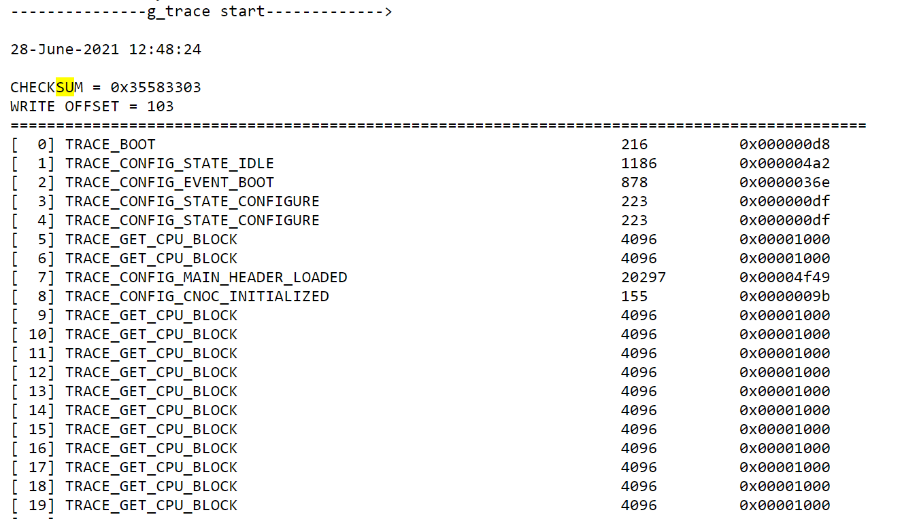
Approach
There are two types of traces nios trace and gtrace that is generated in stdout file when a test is run.
The tool would use the gtrace as an input to do the analysis on.

Slide 6
Approach (Cont.)
Algorithm IntelligentFirmwareTraceTracker():
Input : stdout.txt (Containing gtraces)
Output: Probable code section causing the trace ERROR
Parsing the input text file (i.e., stdout.txt) to identify gtrace section.
Searching for an “_ERROR” string within the identified gtrace section.
Locate the trace just prior to identified _ERROR trace in the stdout file.
Also extract the line number corresponding to the line located in step-3.
Search the (TRACE_ERROR_NAME, LINE_NO) in bottom-to-top manner and return list of directories matching the search.
Analyze the list of directories and find most probable ERROR causing file or section of code.

Slide 7
Method
Tool maintains large database of success scenarios, transition and state machine.
These databases can be continuously upgraded.
The target trace and In the regression portal (pert/arc) - find an automated way to compare the failures logs and with last known best pass log and converge towards the root cause.
The developer does not need to need to start from scratch for a failure and gets intelligent input from the system where the issue is isolated.

Slide 8

Questions??

Slide 9
Thank you!! ☺

Slide 10

Feedback

